Slide 1

ONLINE FEE PAYMENT
UNDER THE ESTEEMED GUIDANCE OF
Ms. P. SRI SILPA, M.Tech (Ph.D)
ASSOCIATED PROFESSOR
SUBMITTED BY,
Mr. P. LEELAPRASAD (20KT1A4238)

Slide 2
CONTENTS
ABSTRACT
INTRODUCTION
HARDWARE REQUIREMENTS
SOFTWARE REQUIREMENTS
EXISTING SYSTEM
PROPORSED SYSTEM
OUTPUT
CONCLUSION
THANK YOU
QUERIES

Slide 3
ABSTRACT
PSCMRCET has a large number of students who pay all the college fees through cash deposits, electronic funds transfer or bank drafts to the college’s accounts in specific bank branches.
This methods of paying fees have not been efficient enough especially during periods of tests and examinations when most of the students are paying fees to meet the requirements for before entering examination rooms.
The process of paying fees is characterized by long queues, too much waiting by students and congestion at banks where payments are made.
This has always resulted in students missing to sit for their tests and/or examinations while they are queuing to make payments.

Slide 4
CONTD...
It was upon such background that the researchers embarked on the project to develop of an alternative system that enables online fees payment by students and their Guidance.
With the use of questionnaires, interviews, observation and document reviews, data was collected from project stakeholders and analyzed. Data flow diagrams and Entity relationship diagrams were used to accomplish system analysis and design.
The system was implemented using Apache web server, Mysql database server, Hypertext Preprocessor, Hypertext markup language, Cascading style sheets and JavaScript.

Slide 5
Contd...
System testing and validation was also done by allowing users of the system interact with it using test data.
Findings showed that most of the students were unsatisfied with the current modes of paying fees to the college and agree that an online fees payment system can improve the process of fees payment.
The result of the project was an online fees payment system for Potti Sriramulu Chalavadi Mallikarjunarao College of Engineering & Technology (PSCMRCET) and researchers recommend the college to implement the system that provides relief of the long endured problems of the current modes of payment at the college.

Slide 6
INTRODUCTION
1.1 Introduction
Fees payments by students in PSCMR College are made through cash deposits, Electronic Funds Transfer (EFT) and Bank drafts to the college’s accounts in specific bank branches (PSCMRCET, 2008 ). For nearly every business, the simple act of collecting payments from consumers is actually quite complex. Organizations want to make it easy and convenient for students to pay, so they offer multiple choices of payment types and channels”. Therefore, the project provides an alternative method that enables secure online fees payment by students and their sponsors.

Slide 7
Contd...
1.2 Background
PSCMRCET has a large number of students who are supposed to pay all the College fees through cash deposits or bank drafts to the College’s accounts in specific bank branches. This method of paying fees has not been efficient enough especially during periods of tests and examinations when most of the students are paying fees to meet the requirements for entering examination rooms. The process of fees payment in such periods is characterized by long queues, too much waiting by students and congestion at banks where payments are made. Students queue to pay fees and those who do not reach counters within the banks‟ working hours are advised to return the next day. This process has always resulted in students missing to sit for their tests and/or examinations while they are queuing to make payments.

Slide 8
Contd...
It has also resulted to too much costs and a lot of time used in transferring and withdrawing money whenever sponsors of students make money transfers to students who can pay College fees at specific bank branches. The process requires sponsors of students from wherever they are to send money to students through either banks, mobile money or any other possible way(s) so that students pay College fees or use EFT that require swift codes to pay fees to the College. This consumes time and sponsors incur extra costs in this process of sending money to students. It was upon this background that the researchers suggested an alternative method which enables secure online fees payment by students and their sponsors.

Slide 9
Contd....
It has also resulted to too much costs and a lot of time used in transferring and withdrawing money whenever sponsors of students make money transfers to students who can pay College fees at specific bank branches. The process requires sponsors of students from wherever they are to send money to students through either banks, mobile money or any other possible way(s) so that students pay College fees or use EFT that require swift codes to pay fees to the College. This consumes time and sponsors incur extra costs in this process of sending money to students. It was upon this background that the researchers suggested an alternative method which enables secure online fees payment by students and their sponsors.

Slide 10
Contd...
Problem Statement
The available modes of fees payment to PSCMRCET through cash deposits, Electronic Funds Transfer (EFT) and bank drafts have caused long queues, students missing to sit for their tests and examinations, and loss of money intended for fees while waiting to reach bank counters to make payments among others. The problem is addressed by developing a system that enables students and their sponsors to securely pay College fees online from wherever they are using credit and debit cards or other UPI payment options.

Slide 11
Contd..
Main Objective
To develop an online fees payment system that enables students and their sponsors to securely pay College fees online using credit and debit cards or other UPI methods, Net-Banking.

Slide 12
Contd...
Specific Objectives
To review the existing system used in paying College fees so that its strength and weaknesses are identified.
To design a new system that enables students and their sponsors to pay College fees online from wherever they are using credit and debit cards.
To implement the prototype of the designed system.
iv. To test and validate the system prototype.

Slide 13
Contd...
Scope of the Study
The study was carried out in PSCMRCET and was intended to offer an extra channel for fees payment, through the development of a secure online fees payment system. The study focused on the development of a web based system that allows secure online fees payment for PSCMRCET. The system will be used by students and their sponsors to pay all kinds of College fees online, and by College accounts offices to verify students‟ payments. The system captures financial information after payments are made.

Slide 14
Contd...
Significance
Literature asserts that, for nearly every business, the simple act of collecting payments from consumers is actually quite complex and yet organizations want to make it easy and convenient for customers to pay, so they offer multiple choices of payment types and channels. (PSCMRCET, 2008). Therefore, this project proposed the development of an alternative platform that enables students and their sponsors securely pay College fees online from wherever they are using credit and debit cards.

Slide 15
Contd...
This will reduce the lengthy queues, and congestion at banks for payments. Further still, the project will also help to reduce the number of students that currently miss sitting their tests and examinations while waiting to reach bank counters to make payments. Sponsors of students, especially those abroad, will save money and time since it will no longer necessitate them to first transfer money to students before it is paid to the College.

Slide 16
Hardware requirements
 | Windows requirements | Mac requirements | Linux requirements
Operating system | Windows 8 or later | macOS Sierra 10.12 or later | 64-bit Ubuntu 14.04+, Debian 8+, openSUSE 13.3+, or Fedora Linux 24+
Processor | Intel Pentium 4 or later | Intel | Intel Pentium 4 or later
Memory | 2 GB minimum, 4 GB recommended
Screen resolution | 1280x1024 or larger
Application window size | 1024x680 or larger
Internet connection | Required

Slide 17
Software requirements
Aside from a computer and an internet connection, most of the tools you need to build a website are software programs, some of which may already be on your computer. You need a text or HTML editor, a graphics editor, web browsers, and an FTP client to upload files to your web server.
1. File Explorer
2. Notepad, Sublime, VSCode.
3. Chrome
4. XAMPP Server.

Slide 18
Existing system
Manual payment takes time
To stand in a queue and pay the fee
Any college students has to stand in cash counters.
If the last date to pay any other fee the students will struggle.
They cannot pay at until the last date.
Then they have to pay the extra fee after the last date.

Slide 19
Proposed system
Ensures the timely payment of fees
Convenient and saves time
Facilitates in paperless administration and office work
Safe from harmful pathogens and germs
User friendly
Provides greater value for money
Enables better recording and tracking

Slide 20
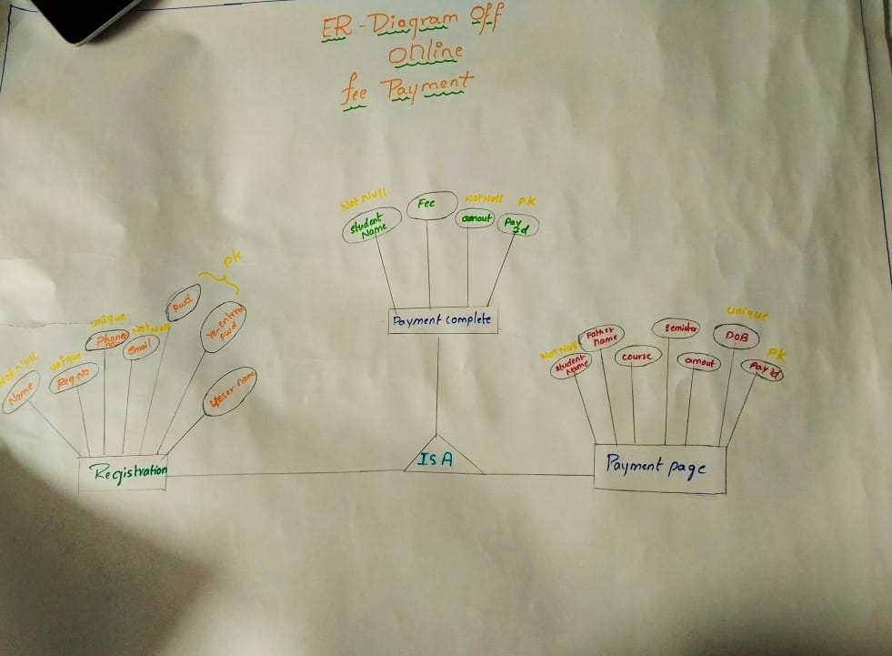
results
ER diagram

Slide 21
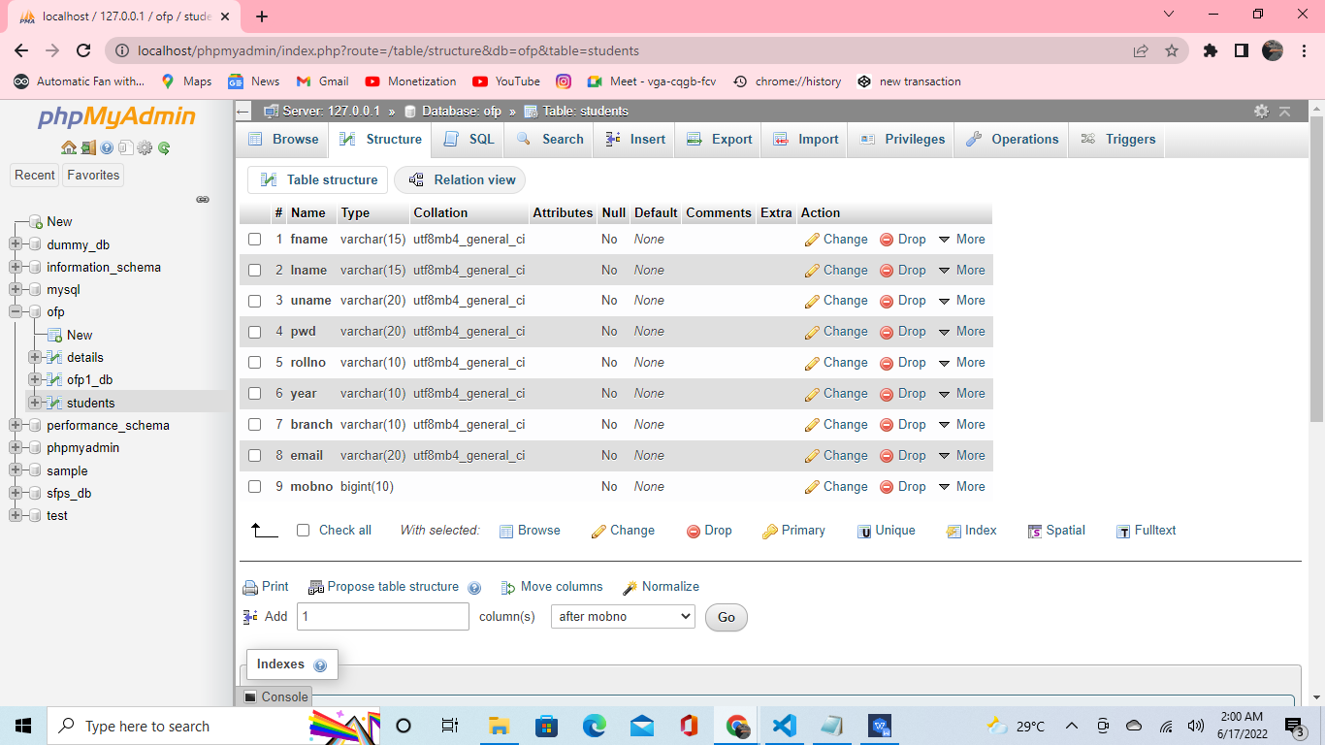
Data-base for Registration page
This is the page that local server through XAMPP server and the registration forms names took from the webpage.

Slide 22
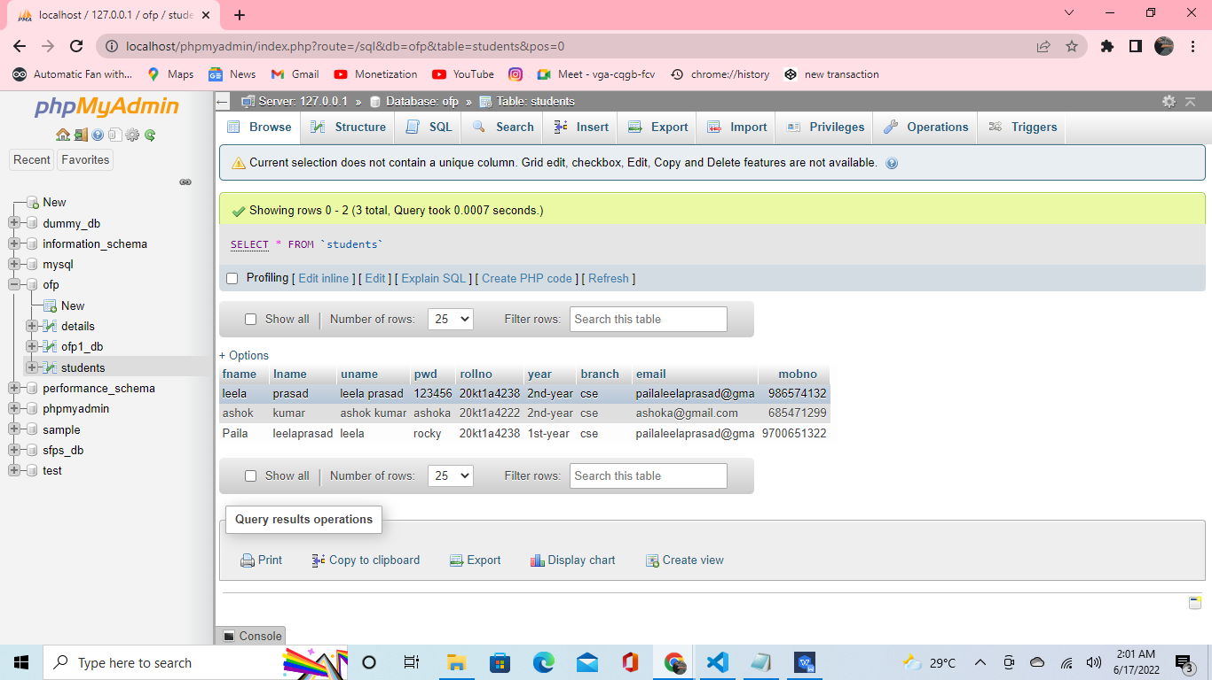
Values-that inserted-from registration page
The values are inserted to the database that means local server of XAMPP and we get the value and everything in the registration form and this can be with only admin.

Slide 23
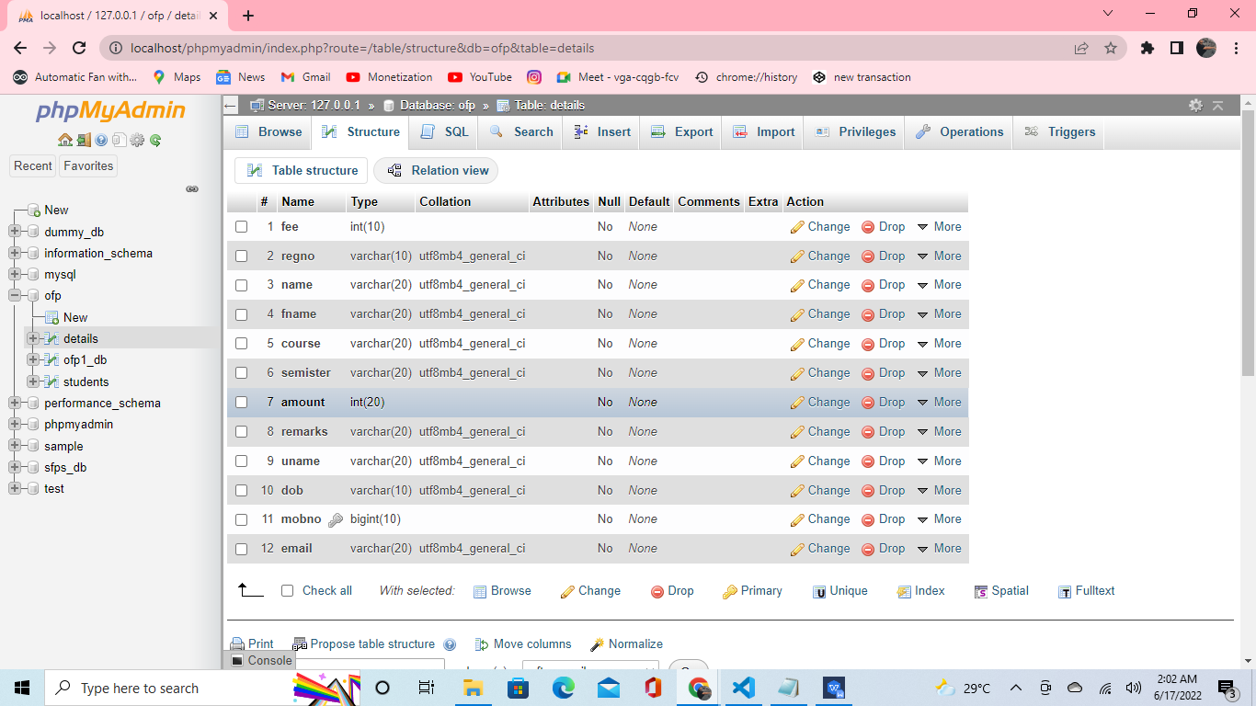
Payment database with their keys

Slide 24
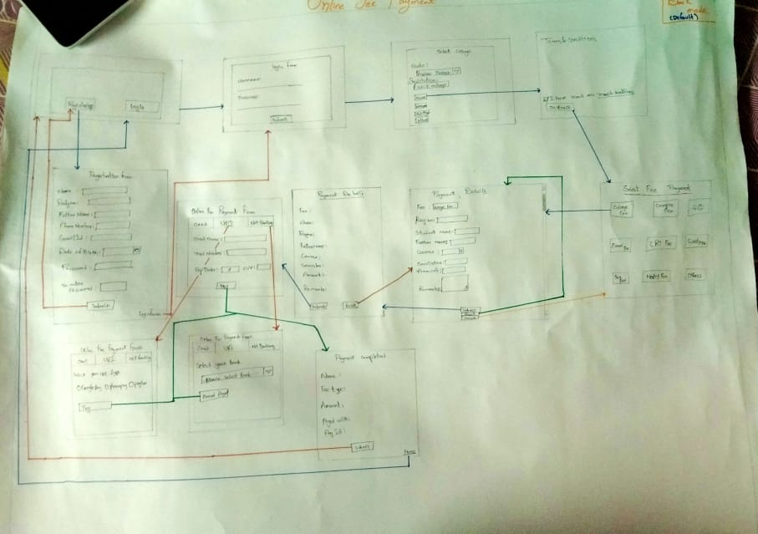
Flow Chart of online fee payment

Slide 25
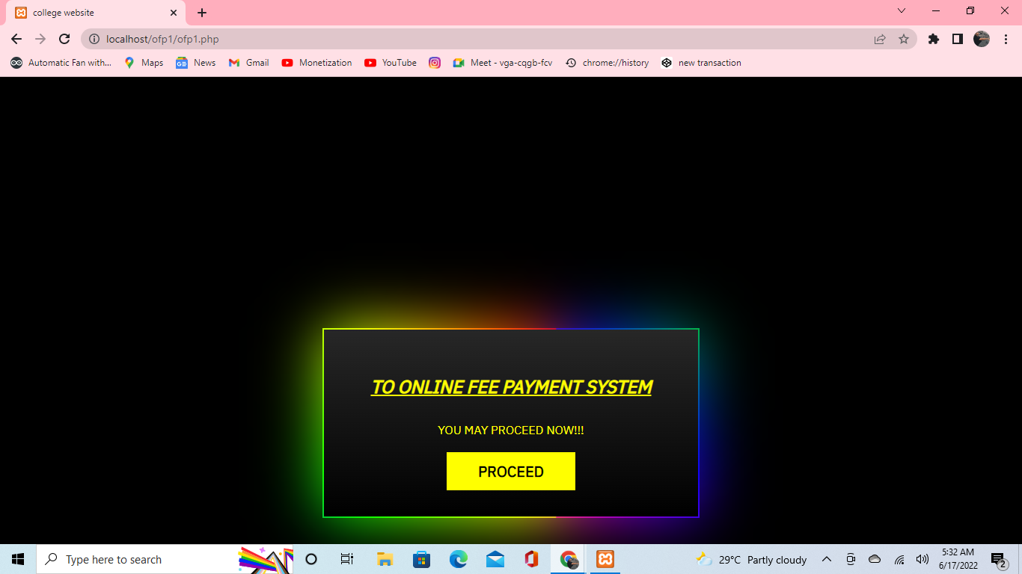
Online Fee payment
Home page of my project there is a button with the name of proceed if you click that then it will go to next page

Slide 26

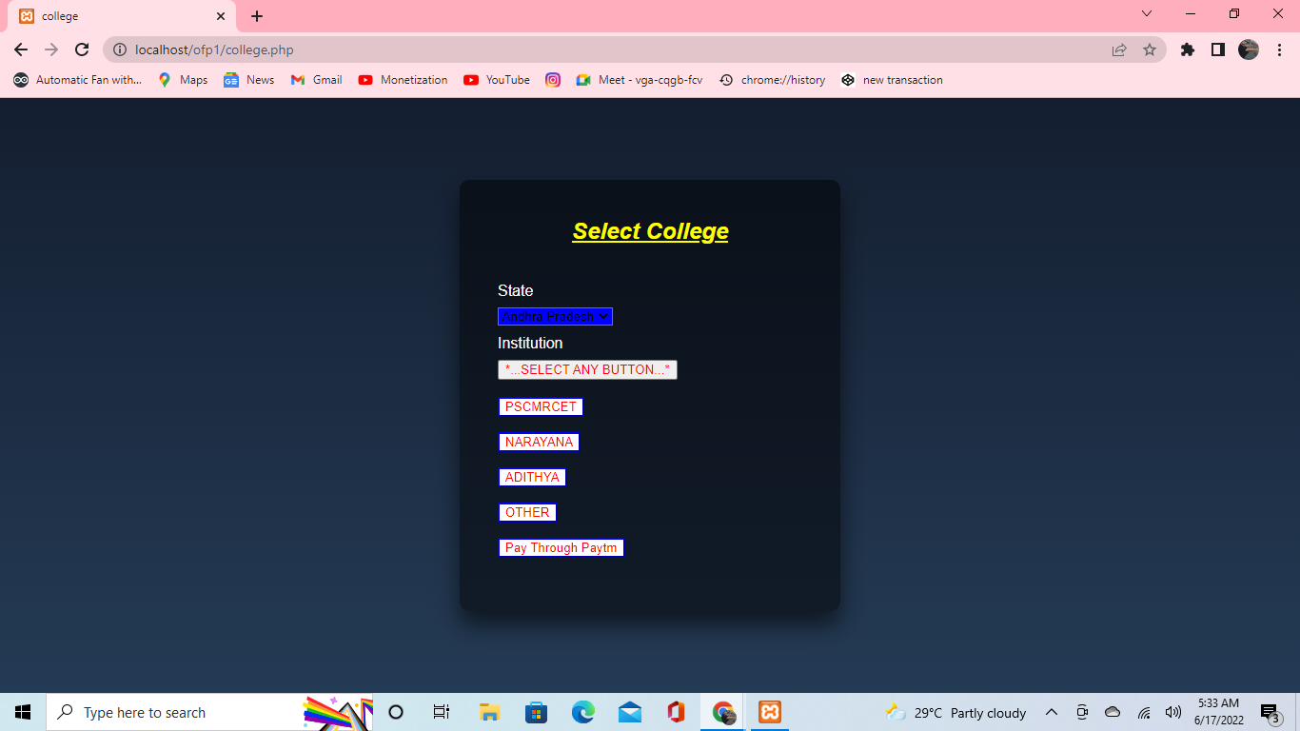
ONLINE FEE PAYMENT
This is the page after clicking the proceed button in this page by default the state is select as Andhra Pradesh and the college is select by manual.
So in this three colleges names are there and others then it will go to next page of AICTE approved engineering colleges in Andhra Pradesh.
There is another way is pay through Paytm if college is integrated with Paytm bank

Slide 27
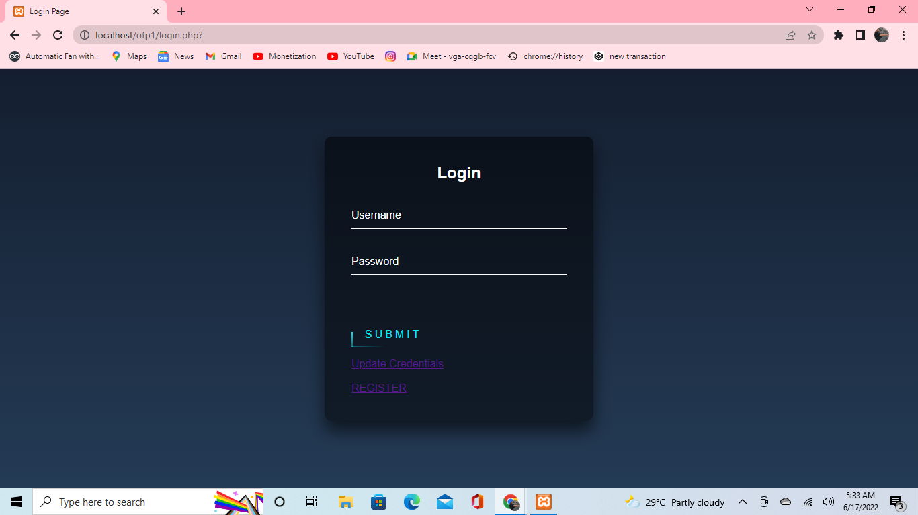
ONLINE FEE PAYMENT
Login page

Slide 28
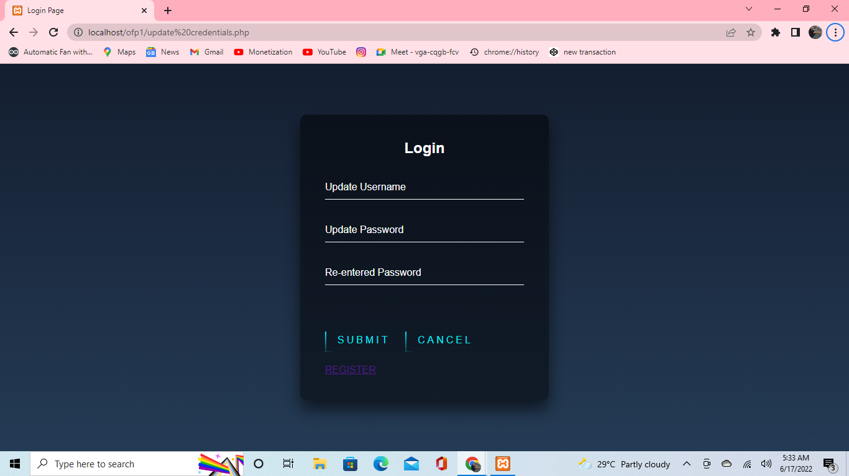
ONLINE FEE PAYMENT
Update credentials page

Slide 29
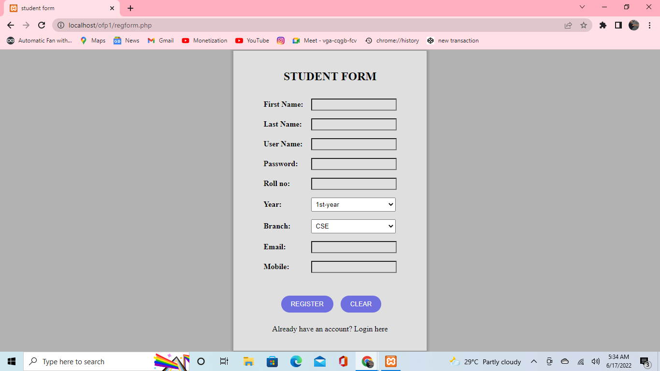
ONLINE FEE PAYMENT
Registration page

Slide 30
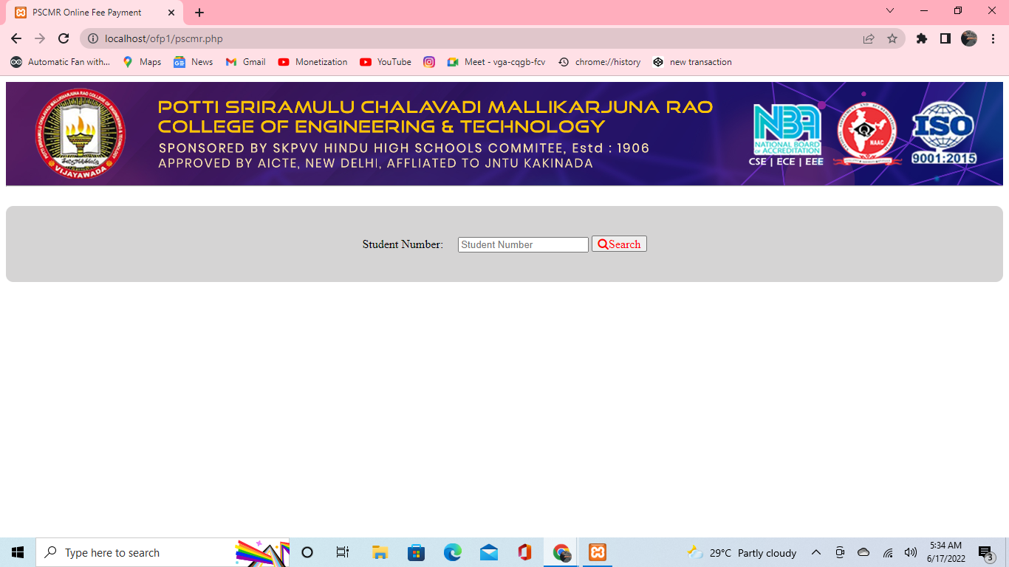
ONLINE FEE PAYMENT
College student retriever

Slide 31
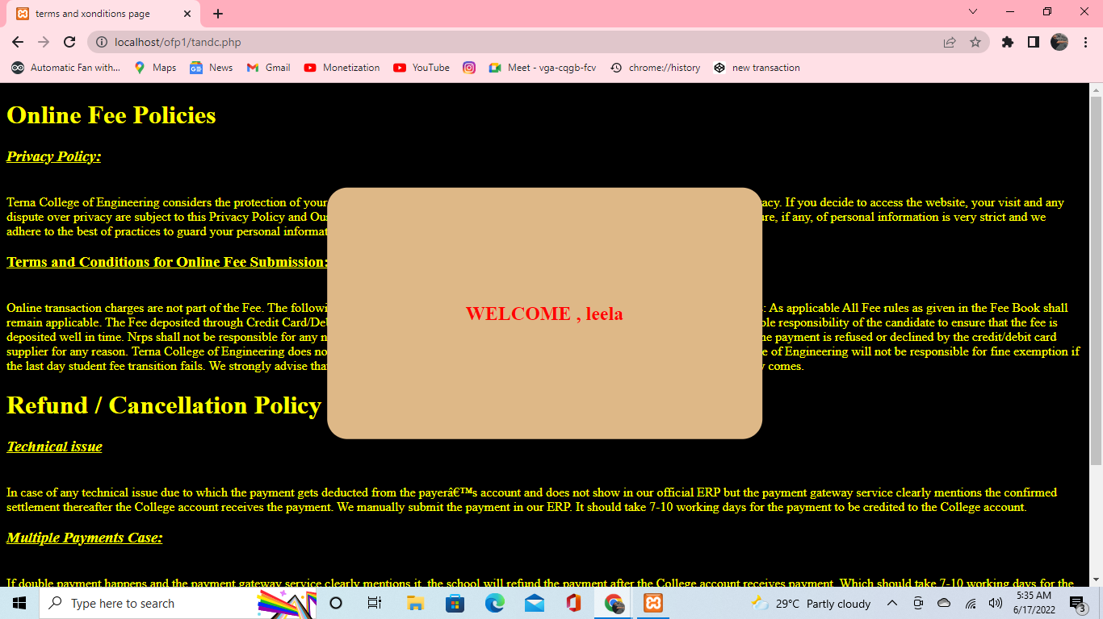
ONLINE FEE PAYMENT
Terms and conditions page

Slide 32
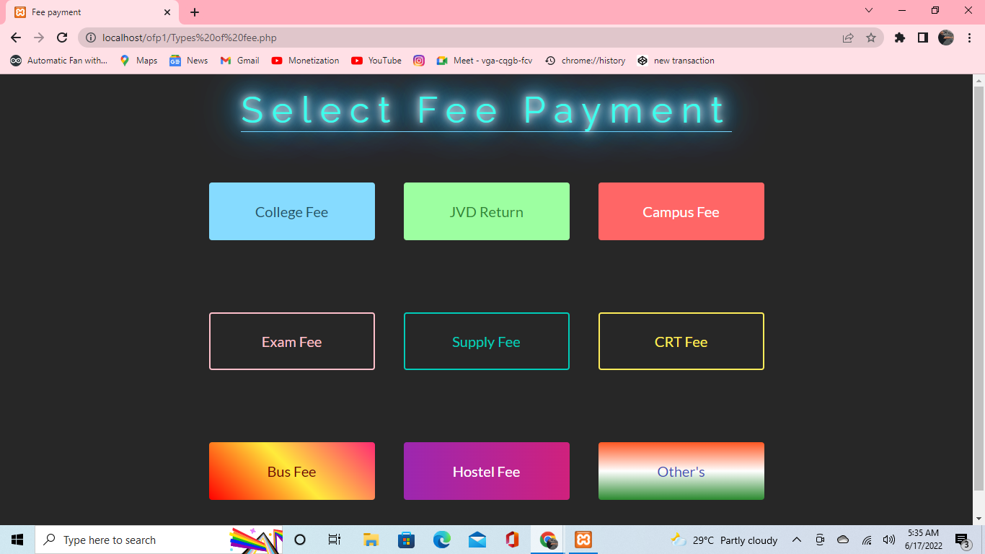
ONLINE FEE PAYMENT
Select fee payment types if any other enter the last others button

Slide 33
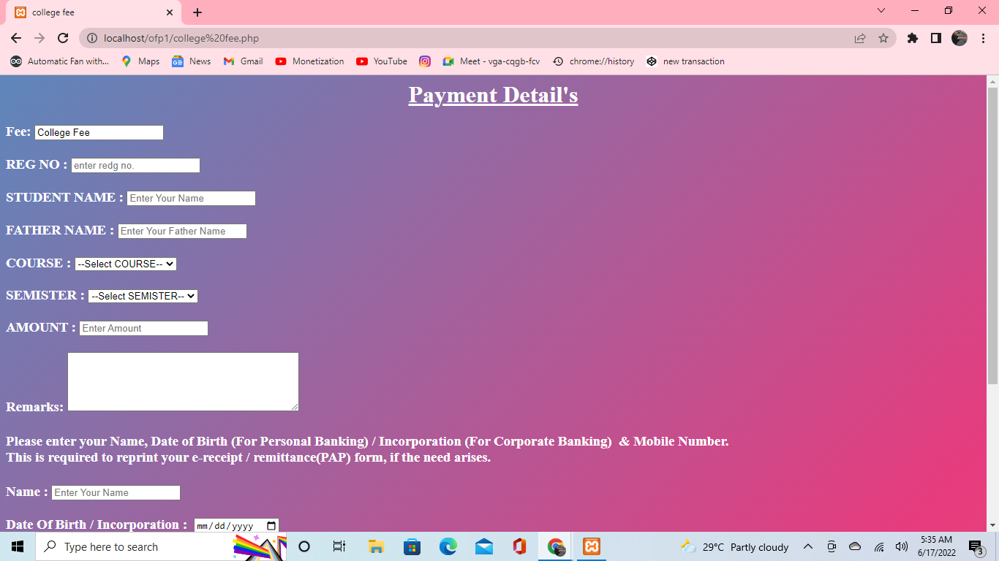
ONLINE FEE PAYMENT
Payment details page to read the data from the manual users

Slide 34
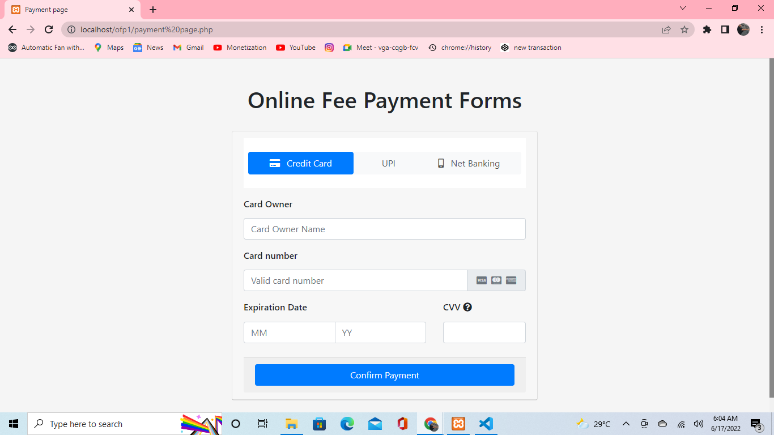
ONLINE FEE PAYMENT
Card payment

Slide 35
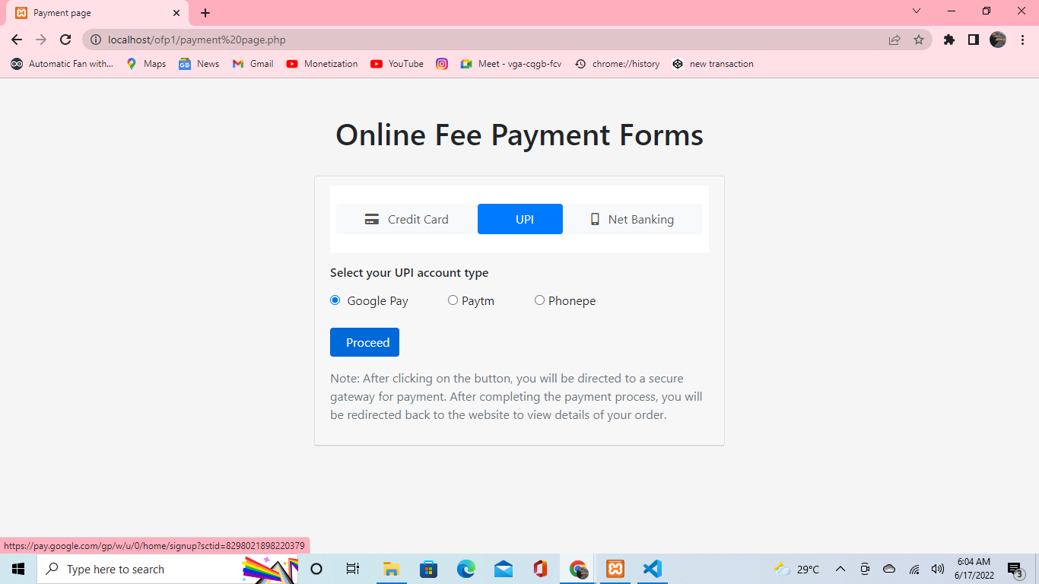
ONLINE FEE PAYMENT
UPI payment

Slide 36
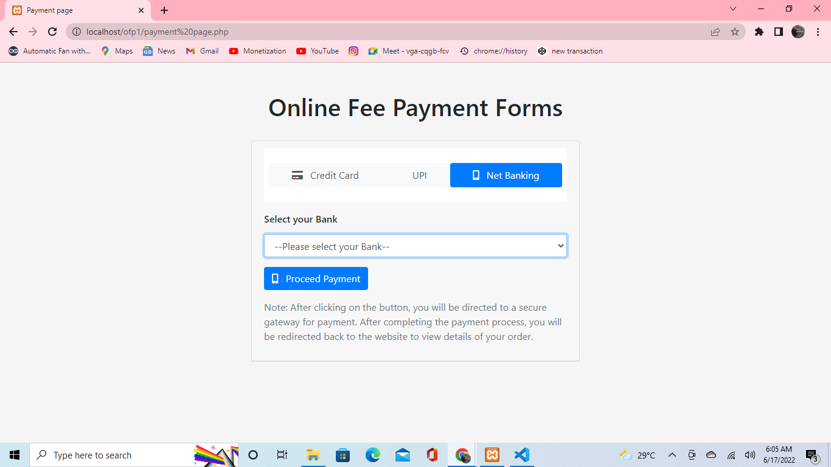
ONLINE FEE PAYMENT
Net banking page

Slide 37
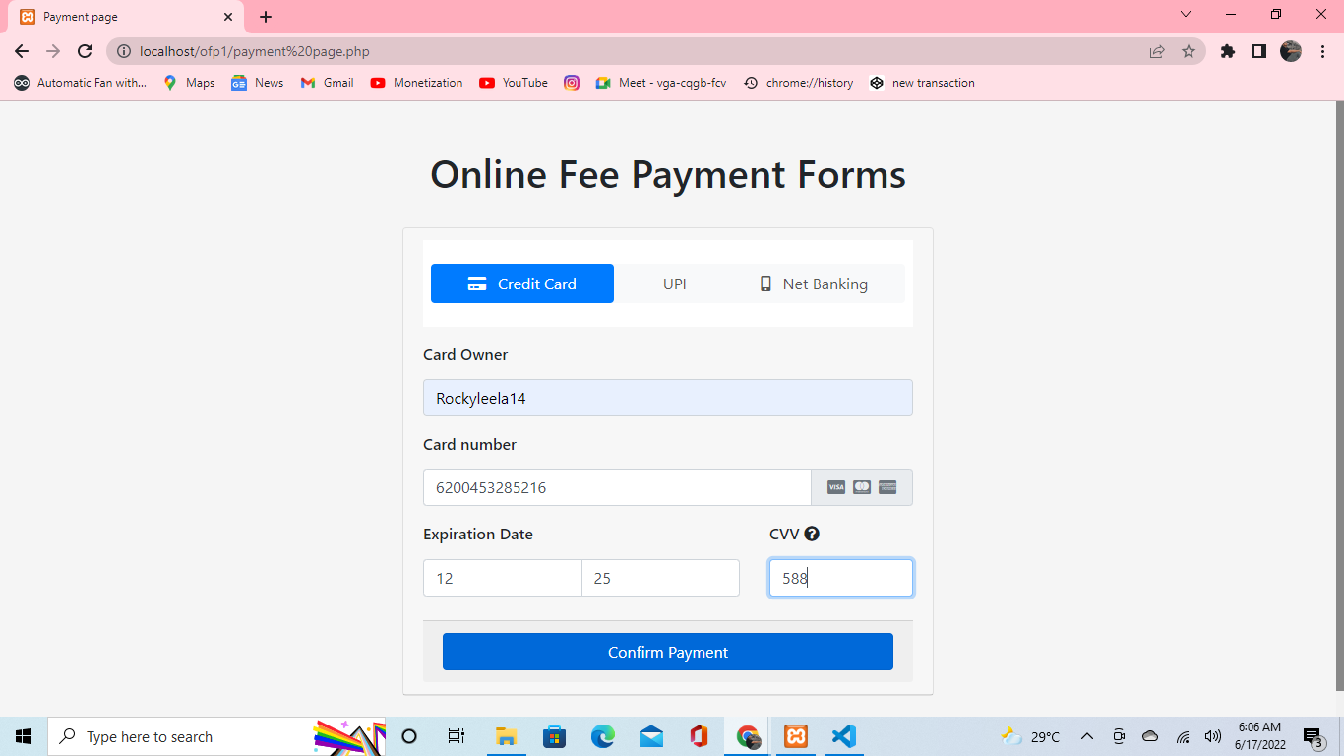
ONLINE FEE PAYMENT
Confirm payment

Slide 38
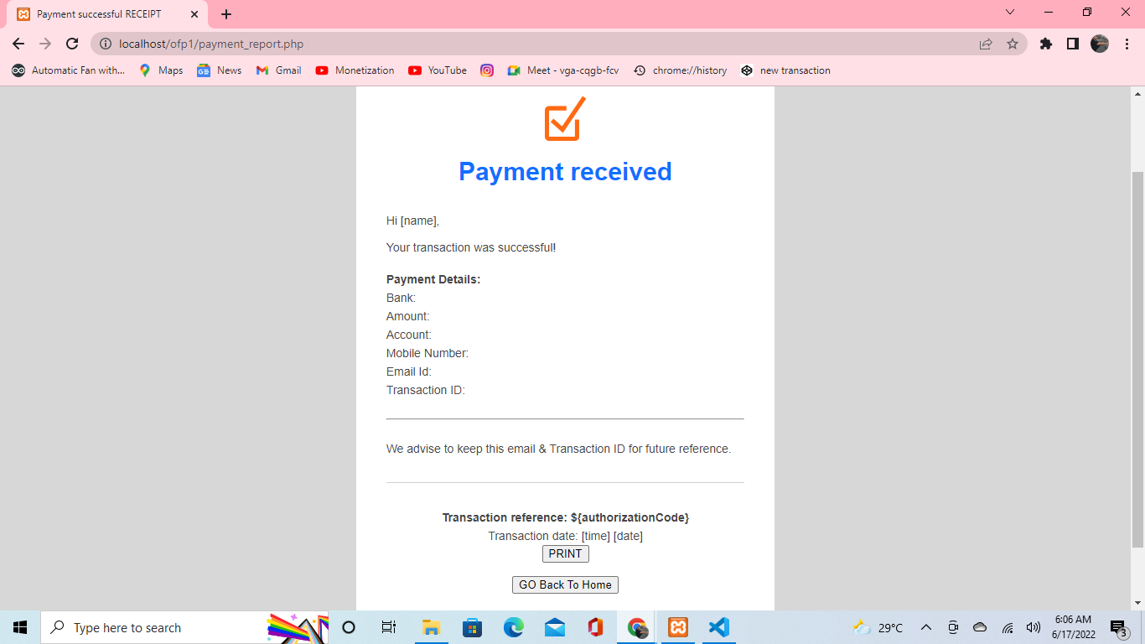
ONLINE FEE PAYMENT
Payment recived recipt

Slide 39
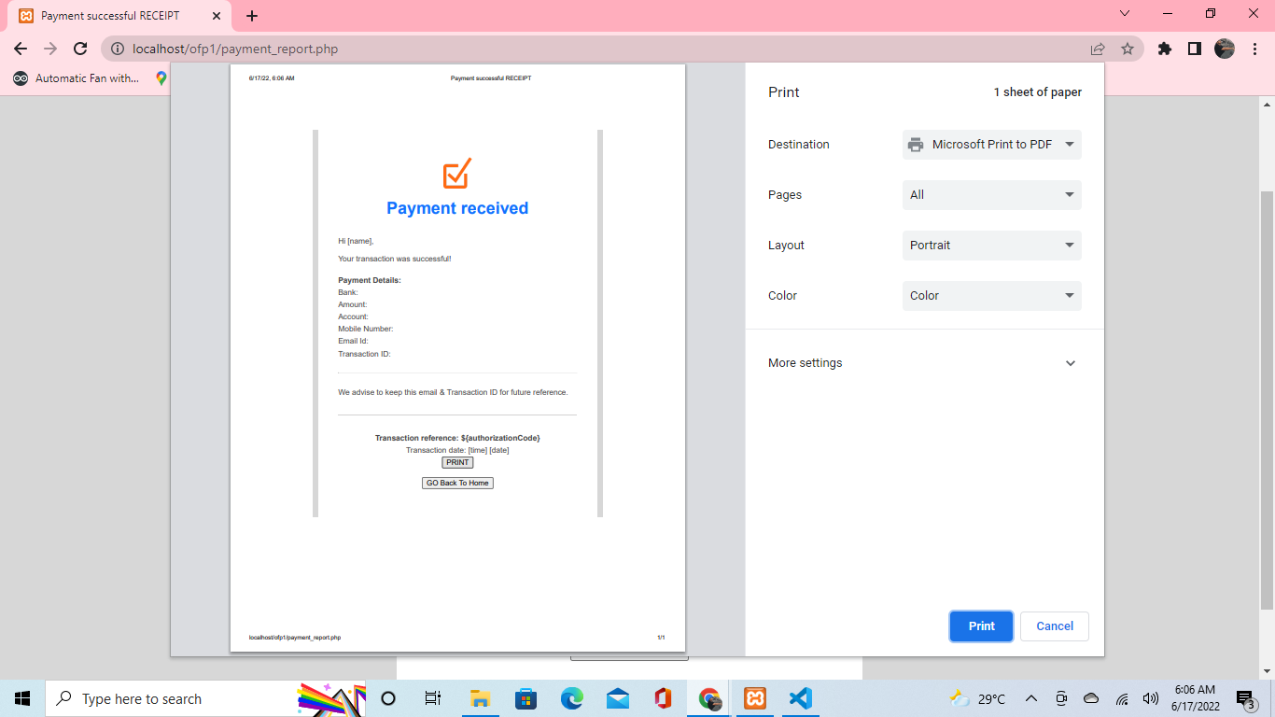
ONLINE FEE PAYMENT
Print the page by clicking the print button

Slide 40
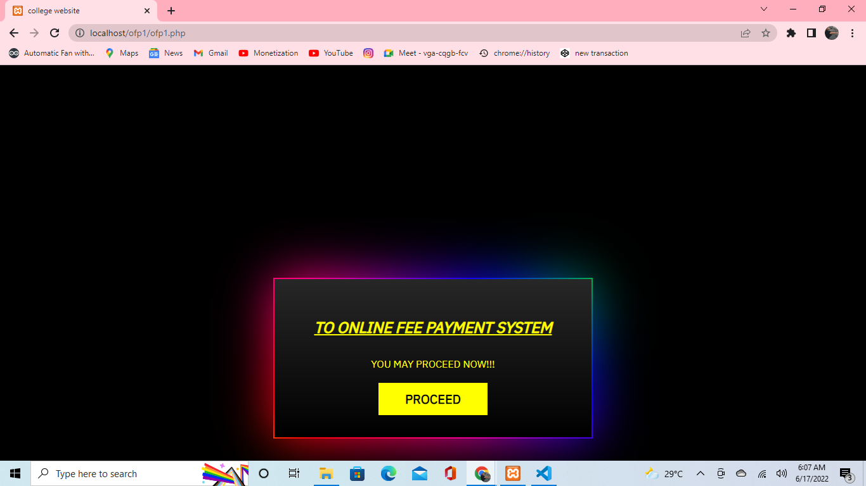
ONLINE FEE PAYMENT
Go to home button this the home page after competition of transaction

Slide 41
conclusion
The project sought to develop an online fees payment system that provides relief of the long endured problems of the current modes of paying fees in PSCMRCET. Problems that students and their sponsors faced regarding paying fees to the university were identified and a solution was designed. Researchers developed a web based system that enables students and their sponsors to pay university fees from wherever they are using credit and debit cards. This system was welcomed by all its users who believed it would solve most of the problems and improve conditions regarding paying fees in PSCMRCET. The project achieved all its objectives and as a result, PSCMR-OFPS was designed, developed, tested and validated with real users. Hence, it was proved that this online system was fit to be implemented.

Slide 42
? Any Questions

Slide 43
Thank you...

